Slide 1
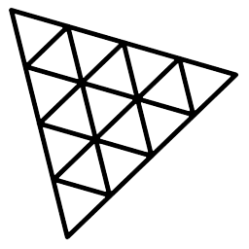
Three.js
3.JS
is
awesome
GUIDE FOR BEGINNERS
PROJECT PROPOSAL

Slide 2
TOPIC 15:
ABOUT
BUDGET
PROJECT
TIMELINE
PHYSICS-CANNON.js
PROJECT PROPOSAL

Slide 3
INTRO TO PHYSICS
COMPARISONS OF JS LIBRARIES
TABLE OF CONTENTS
CANNON.JS
BASIC SCENE
FRICTION & SPIN
SLIP & BOUNCE
Intro To Physics
Comparisons of JS Libraries
CANNON.js
Basic Scene
Friction & SPIN
Slip & Bounce
01
02
03
04
05
05
PROJECT PROPOSAL

Slide 4

Intro To Physics
Intro To Physics
CANNON.js
Basic Scene
Friction & SPIN
Slip & Bounce
01

Slide 5
Intro To Physics
CANNON.js
Basic Scene
Friction & SPIN
Slip & Bounce
Physics can be one of the coolest features you can add to a WebGL experience.
We can collide, collapse, fall and bounce the objects like we experience in real life.
There are many ways of adding physics to your project, and it depends on what you want to achieve. You can create your own physics with some mathematics and solutions like Raycaster, but if you wish to get realistic physics with tension, friction, bouncing, constraints, pivots, etc. and all that in 3D space, you better use a library.

Slide 6
CANNON.js
Intro To Physics
Basic Scene
Friction & SPIN
Slip & Bounce
Intro To Physics
CANNON.js
02

Slide 7
Intro To Physics
CANNON.js
Basic Scene
Friction & SPIN
Slip & Bounce
Libraries:
There are many libraries available for both 2D and 3D physics.
Planck.js, P2.js, Matter.js are 2D Libraries
Cannon.js, Ammo.js, Oimo.js are 3D Libraries
Why we use Cannon.js:
In a 2013 comparison with Ammo.js, cannon.js was found to be "more compact, more comprehensible, more powerful with regard to its performance and also easier to understand", but did not have as many features.^{[4]}
Starting with Cannon.js
First we need to install the cannon.js library using npm.

Slide 8
Intro To Physics
CANNON.js
Basic Scene
Friction & SPIN
Slip & Bounce
Starting with Cannon.js
First we need to install the cannon.js library using npm.
npm install cannon-es
And then import it in your project
import * as CANNON form “cannon-es”
Implementation:
The idea is simple. We are going to create a physics world. This physics world is purely theoretical, and we cannot see it. But in this world, things fall, collide, rub, slide, etc.
When we create a Three.js mesh, we will also create a version of that mesh inside the physics world. If we make a Box in Three.js, we also create a box in the physics world.
Then, on each frame, before rendering anything, we tell the physics world to update itself; we take the coordinates (position and rotation) of the physics objects and apply them to the corresponding Three.js mesh.

Slide 9
Intro To Physics
CANNON.js
Basic Scene
Friction & SPIN
Slip & Bounce
In short there are 4 steps that we need to do;
Create a world with gravity 9.8.
Create objects with the help of THREE.js.
Create transparent entity that we can not see but is affected by physics law like in this world, things fall, collide, rub, slide, etc.
Create Mesh to merge the objects and physics
How will it look like:
const world=new CANNON.World({gravity:new CANNON.Vec3(0,-9.83,0)})
const plane=new THREE.Mesh(new THREE.PlaneGeometry(30,30),new THREE.MeshBasicMaterial({wireframe:true})); scene.add(plane)
const planePhy=new CANNON.Body({}) ; world.addBody(planePhy);
Plane.position.copy(planePhy.position); plane.quaternion.copy(planePhy.quaternion)
We add that in the animation
function

Slide 10
Basic Scene
Basic Scene
Intro To Physics
Basic Scene
Friction & SPIN
Slip & Bounce
Intro To Physics
CANNON.js
03

Slide 11
Intro To Physics
CANNON.js
Basic Scene
Friction & SPIN
Slip & Bounce
<Basic Scene/> which includes plane, cube and sphere
//world
const world=new CANNON.World({
gravity:new CANNON.Vec3(0,-9.83,0),
})
const timeStep=1/60;
//phy of plane
const planePhy=new CANNON.Body({
shape:new CANNON.Box(new CANNON.Vec3(15,15,0.1)),
type: CANNON.Body.STATIC,
material:planePhyMaterial
})
world.addBody(planePhy)
planePhy.quaternion.setFromEuler(-Math.PI/2,0,0)
//phy of sphere
const spherePhy=new CANNON.Body({
shape:new CANNON.Sphere(2),
mass:2,
position:new Vec3(1,20,0),
material:spherePhyMaterial
})
world.addBody(spherePhy)
// phy of box
const boxPhy=new CANNON.Body({
shape:new CANNON.Box(new CANNON.Vec3(1,1,1)),
mass:1,
position:new Vec3(0,25,0),
material:boxPhyMaterial
})
world.addBody(boxPhy)
Then in animation
world.step(timestep)

Slide 12
Intro To Physics
CANNON.js
Basic Scene
Friction & SPIN
Slip & Bounce
const anim=()=>{
requestAnimationFrame(anim)
world.step(timeStep)
plane.position.copy(planePhy.position)
plane.quaternion.copy(planePhy.quaternion)
sphere.position.copy(spherePhy.position)
sphere.quaternion.copy(spherePhy.quaternion)
box.position.copy(boxPhy.position)
box.quaternion.copy(boxPhy.quaternion)
renderer.render(scene,camera)
}
anim();

Slide 13
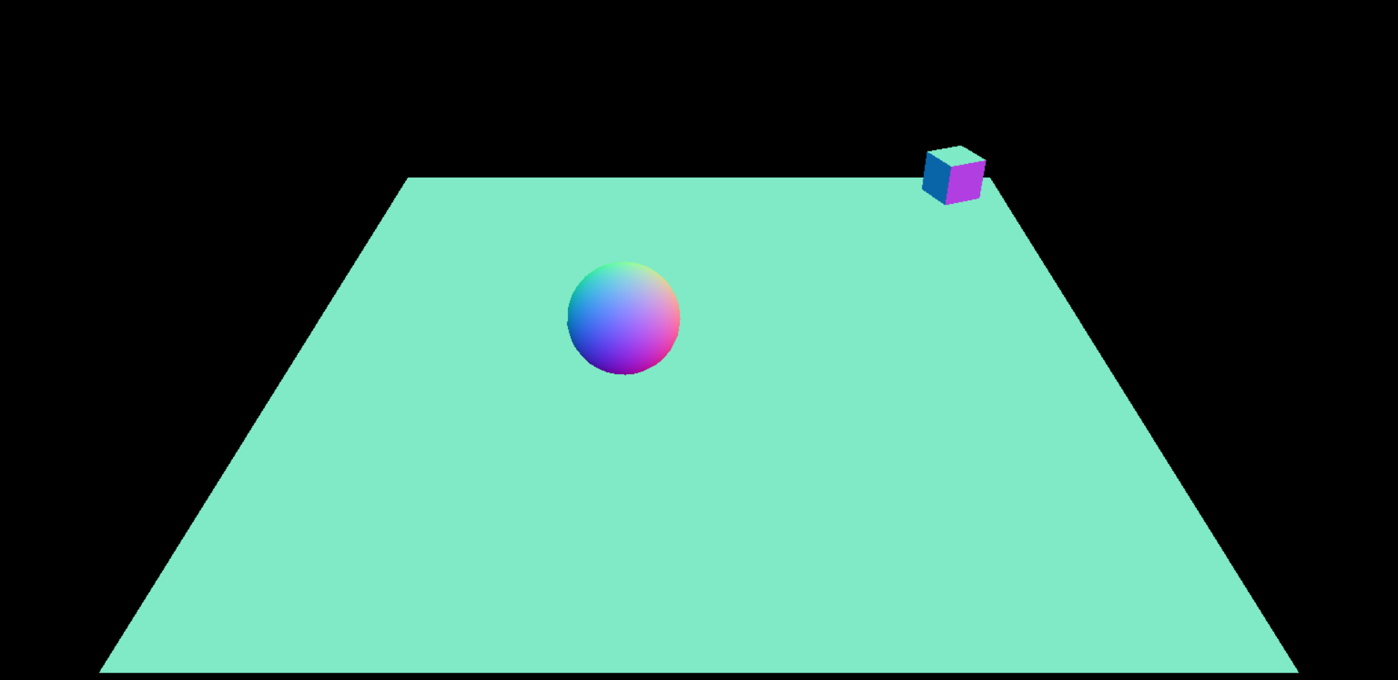
Intro To Physics
CANNON.js
Basic Scene
Friction & SPIN
Slip & Bounce

Slide 14
Friction & Spin
Intro To Physics
CANNON.js
Basic Scene
Friction & SPIN
Slip & Bounce
04

Slide 15
Intro To Physics
CANNON.js
Basic Scene
Friction & SPIN
Slip & Bounce
For friction we write;
spherePhy.linearDamping=0.5;
To spin an object, we write;
spherePhy.angularVelocity.set(10,0,0)
To give friction to the spin we write;
spherePhy.angularDamping=0.4;

Slide 16
Slip & Bounce
Intro To Physics
Basic Scene
Friction & SPIN
Slip & Bounce
Intro To Physics
CANNON.js
05

Slide 17
Intro To Physics
CANNON.js
Basic Scene
Friction & SPIN
Slip & Bounce
const planePhyMaterial=new CANNON.Material()
SLIP
const boxPhyMaterial=new CANNON.Material()
boxPhy.material=boxPhyMaterial
const boxContactMeterial=new CANNON.ContactMaterial(planePyMaterial,boxPhyMaterial,{friction:0})
world.addContactMaterial(bCM)
BOUNCE
const spherePhyMaterial=new CANNON.Material()
spherePhy.material=spherePhyMaterial
const sphereContactMaterial=new CANNON.ContactMaterial(planePhyMaterial,sphereMaterial,{restitution:1})
world.addContactMaterial(sCM)

Slide 18
THANKS!
ABOUT
BUDGET
PROJECT
TIMELINE
Do you have any questions?
EMAIL: aadnanshahh2001@gmail.com
GITHUB: https://github.com/AdnanShahSahb
Please keep this slide for attribution
PROJECT PROPOSAL

